Slide 1

(9)
Foreign Key
Infoway Technologies, 3rd Floor Commerce Centre, Rambaug Colony, Paud Road Pune 411038

Slide 2
(9)
Foreign Key
A FOREIGN KEY is a key used to link two tables together. A FOREIGN KEY is a field (or collection of fields) in one table that refers to the PRIMARY KEY in another table. The table containing the foreign key is called the child table, and the table containing the candidate key is called the referenced or parent table.
Note:
The table containing the FOREIGN KEY is referred to as the child table, and the table containing the PRIMARY KEY (referenced key) is the parent table.
PARENT and CHILD tables must use the same storage engine,
and they cannot be defined as temporary tables.
Infoway Technologies, 3rd Floor Commerce Centre, Rambaug Colony, Paud Road Pune 411038

Slide 3
Rules of Foreign Key
(9)
FOREIGN key condition must follow some rules.
A foreign key column can have a different name from its primary key column.
DataType of primary key and foreign key column must be same.
It ensures rows in one table have corresponding rows in another.
Foreign keys can be NULL value even though primary keys can not.
Infoway Technologies, 3rd Floor Commerce Centre, Rambaug Colony, Paud Road Pune 411038

Slide 4
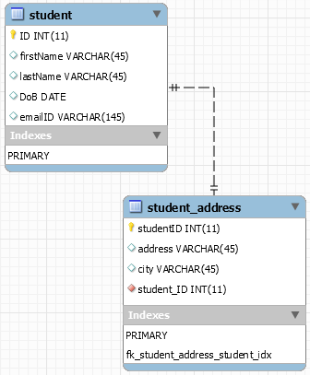
Examples of Foreign Key
(9)
CREATE TABLE student (
ID INT(11) PRIMARY KEY,
firstName VARCHAR(45),
lastName VARCHAR(45),
DoB DATE,
emailID VARCHAR(145)
);
CREATE TABLE student_address (
studentID INT PRIMARY KEY,
address VARCHAR(45),
city VARCHAR(45) ,
FOREIGN KEY (studentID) REFERENCES student(ID)
);
Infoway Technologies, 3rd Floor Commerce Centre, Rambaug Colony, Paud Road Pune 411038

Slide 5
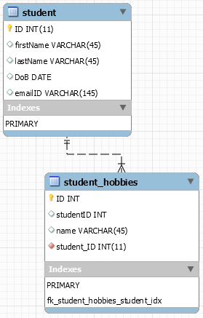
Examples of Foreign Key
(9)
CREATE TABLE student (
ID INT(11) PRIMARY KEY,
firstName VARCHAR(45),
lastName VARCHAR(45),
DoB DATE,
emailID VARCHAR(145)
);
CREATE TABLE student_hobbies (
ID INT PRIMARY KEY,
studentID INT,
name VARCHAR(45),
FOREIGN KEY (studentID) REFERENCES student(ID)
);
Infoway Technologies, 3rd Floor Commerce Centre, Rambaug Colony, Paud Road Pune 411038

Slide 6
INSERT
The INSERT INTO statement is used to add new rows of data to a table in the database.
INSERT INTO student_address VALUES (1, 'paud road', 'pune');
INSERT INTO student_address VALUES (2, 'M.G. road', 'baroda');
INSERT INTO student_address VALUES (3, 'k.k road', 'surat');
INSERT INTO student_address VALUES (4, 'station road', 'baroda');
INSERT INTO student_hobbies VALUES (1, 1, 'running');
INSERT INTO student_hobbies VALUES (2, 1, 'reading');
INSERT INTO student_hobbies VALUES (3, 2, 'football');
INSERT INTO student_hobbies VALUES (4, 2, 'running');
INSERT INTO student_hobbies VALUES (5, 3, 'watching movies');
INSERT INTO student_hobbies VALUES (6, 4, 'gaming');
Infoway Technologies, 3rd Floor Commerce Centre, Rambaug Colony, Paud Road Pune 411038

